Slide 2
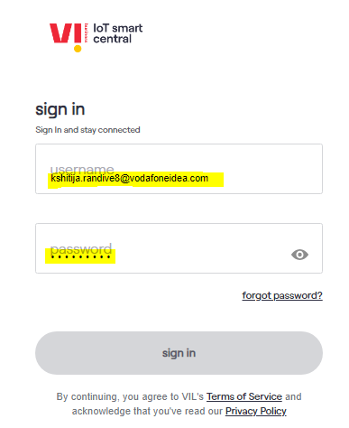
Login to your CMP portal with domain ID and Password

Slide 3
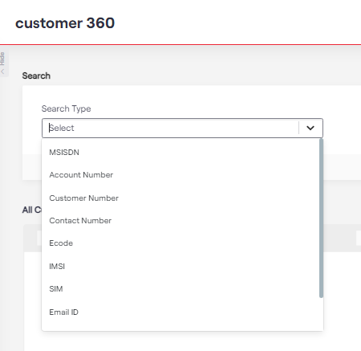
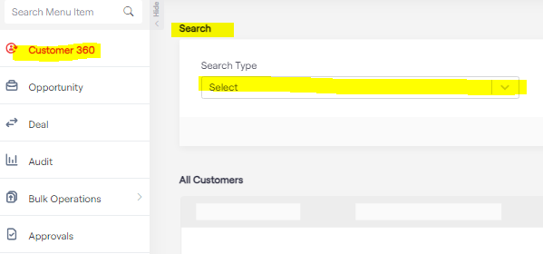
Smart Central Checks
Select the search type in search box, you get below options, MSISDN, SIM number, Account Number etc.

Slide 4
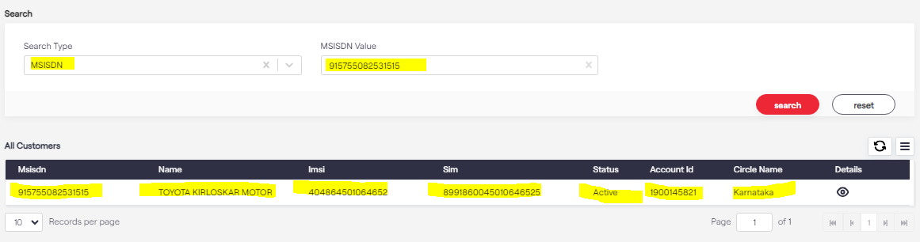
Smart Central Checks
Punch the number in MSISDN value. You will fetch the details as below. Than view the details in details tab

Slide 5
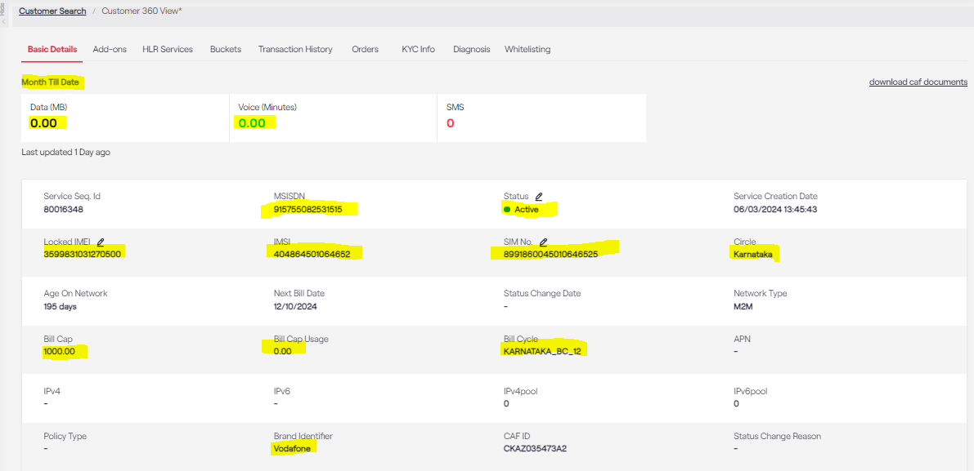
Smart Central Checks
Punch the number in MSISDN value. You will fetch the details as below. Highlighted fields are mandatory.

Slide 6
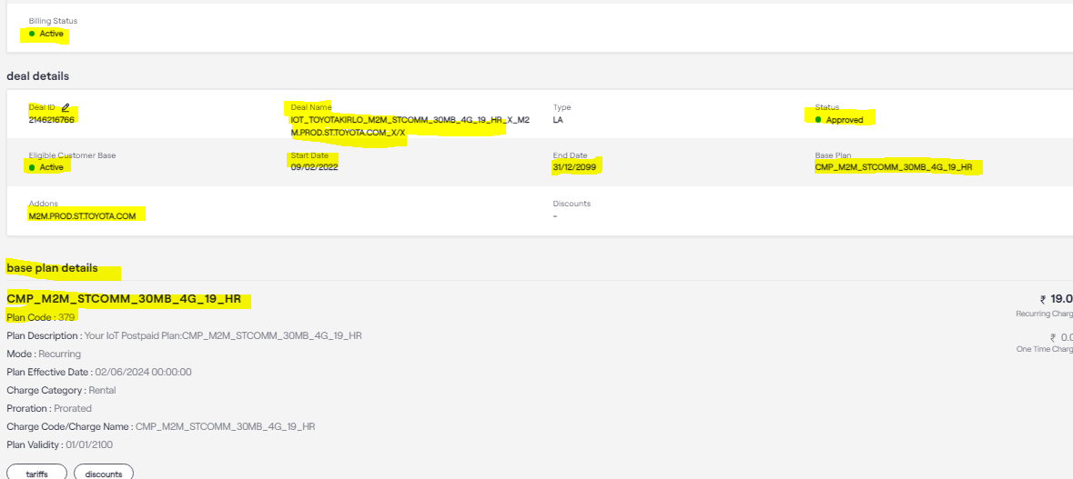
Pre-checks
Check the status of the affected number, Deal Name, APN is correct or not

Slide 7
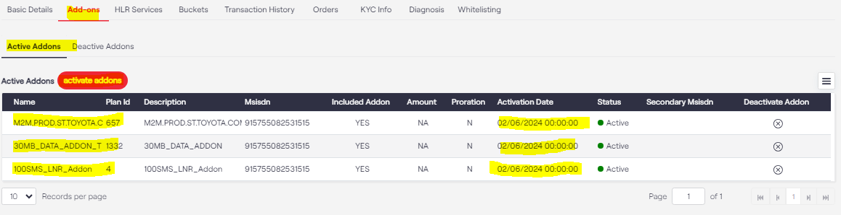
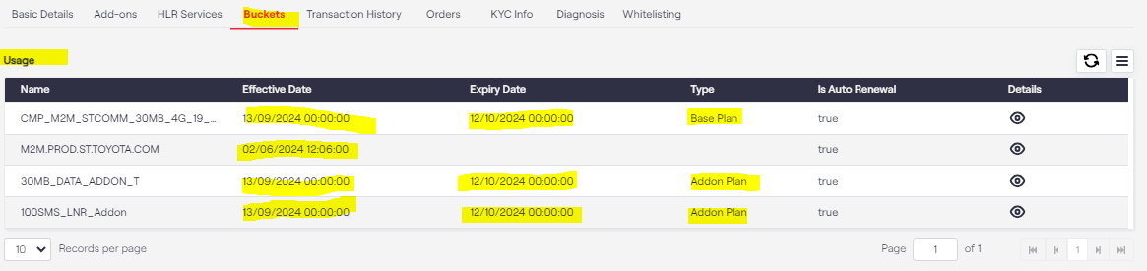
Pre-checks
Check the Add-ons parts. You will able to see which services and plan are active
With Add-ons we need to check Buckets- details- what is active date and expiry date.

Slide 8
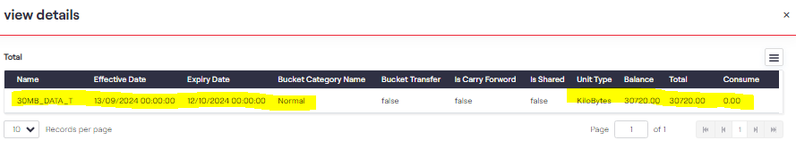
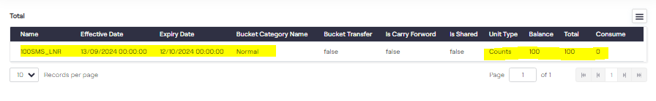
Pre-checks
In buckets we need to check add-on services balance for Data as well as SMS

Slide 9
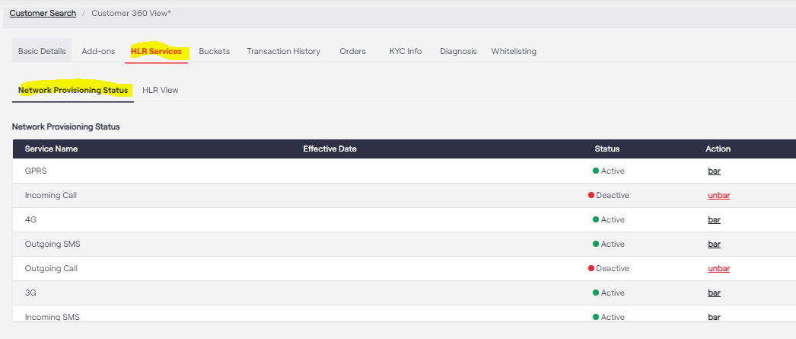
Pre-checks
Pre-checks should be done for all the services in the HLR view and Network Provisioning Status tab.

Slide 10
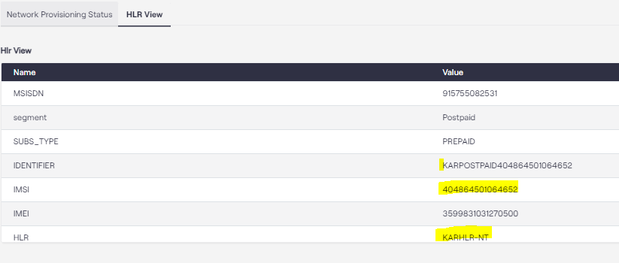
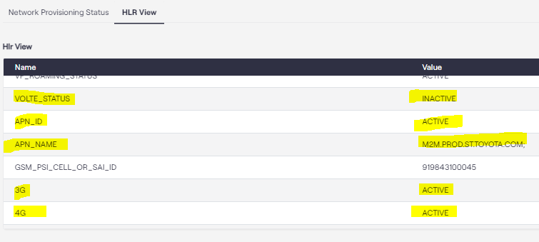
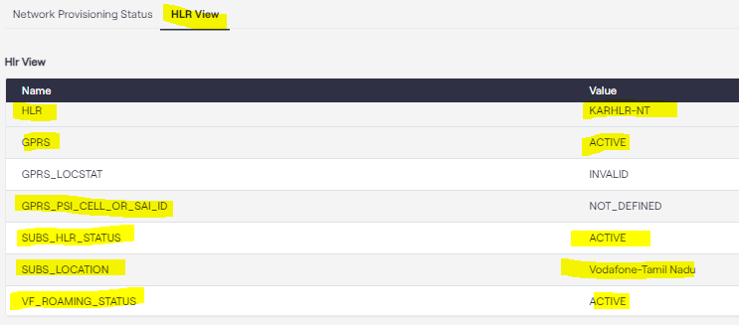
Pre-checks
APN Status- Active
APN ID- Active
GPRS- Active
2G- Active
4G- Active
VOLTE Status- Active
HLR- Active
Roaming- Active
Barring- Inactive

Slide 11
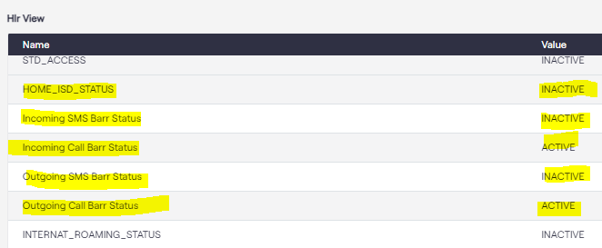
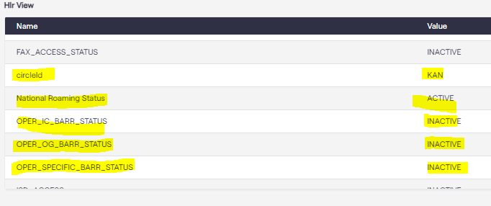
Pre-checks

Slide 12
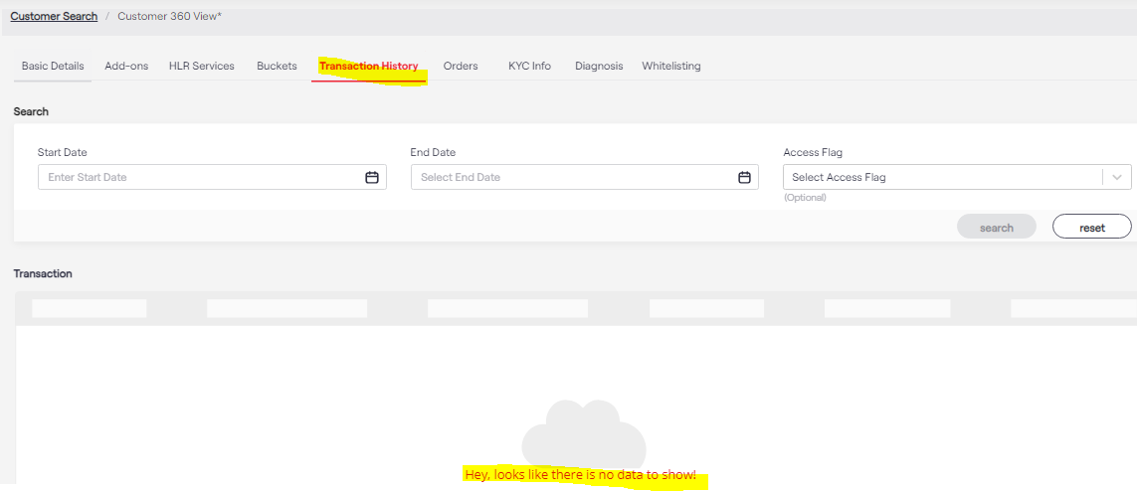
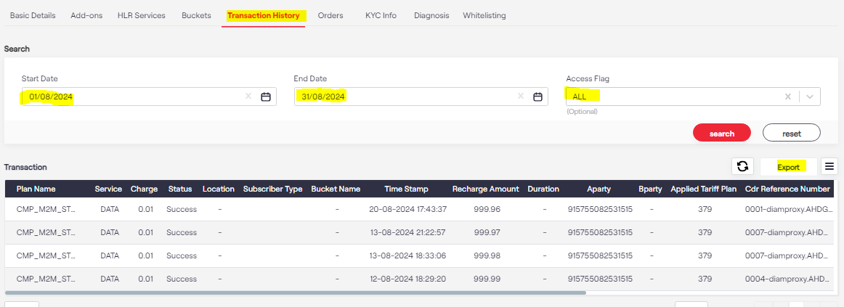
Pre-checks
The latest data transaction history should be checked.
You can select a particular data range also.
Only 90 days of data is stored.

Slide 13
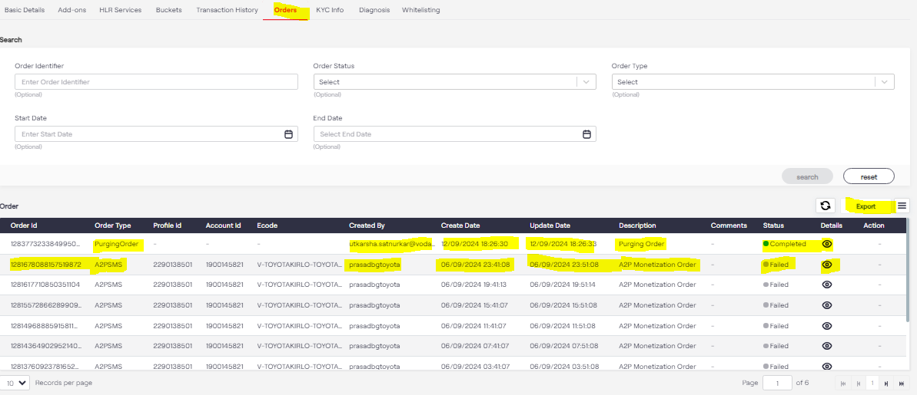
Pre-checks
Check and recent plan changes, deal changes, status changes done on any affected number.

Slide 14
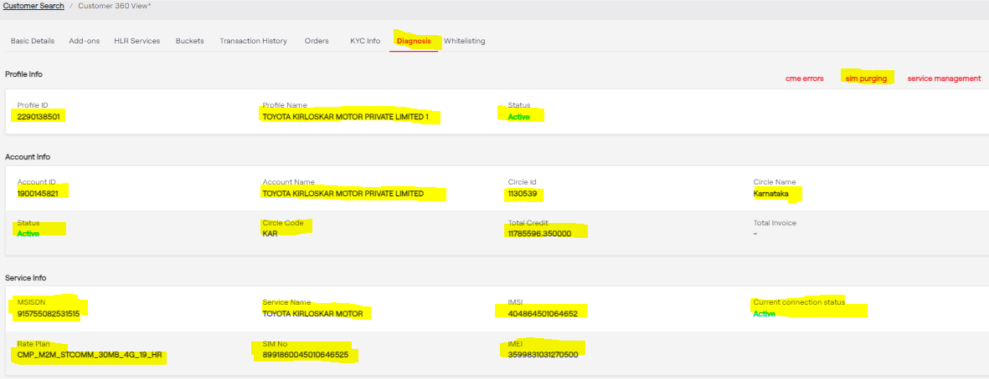
Pre-checks
On the Diagnosis page we can do the SIM purging and also can cross- check the rest of the details that are highlighted

Slide 15
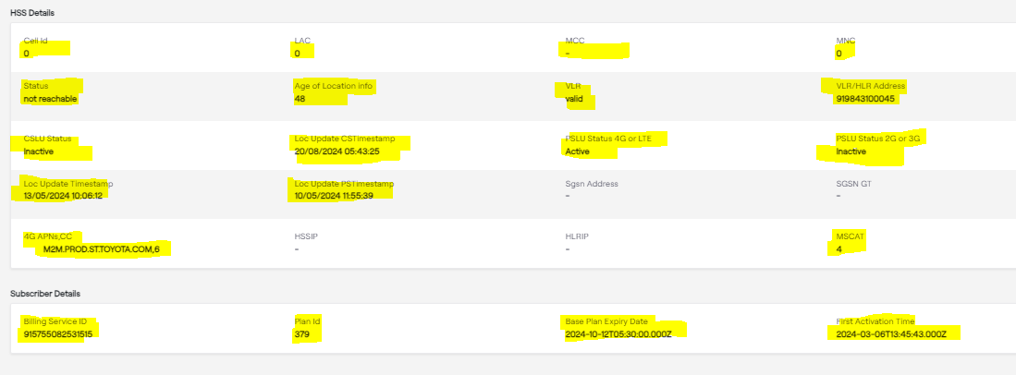
Pre-checks
HSS details will show the HLR deatils

Slide 16
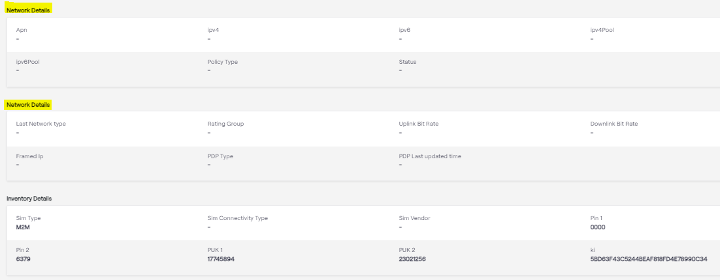
Pre-checks
Used to check AAA configuration
Used to check any normal/ Dynamic HLR configuration

Slide 17
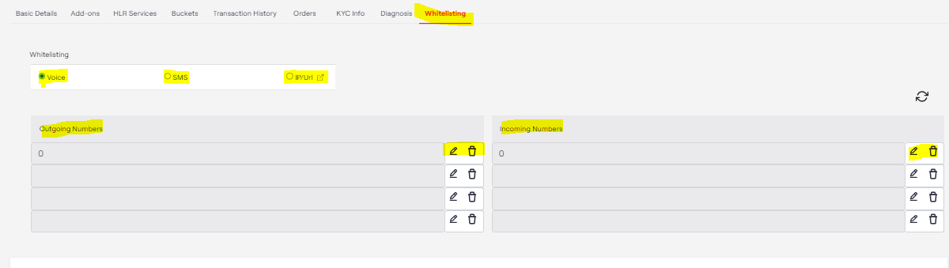
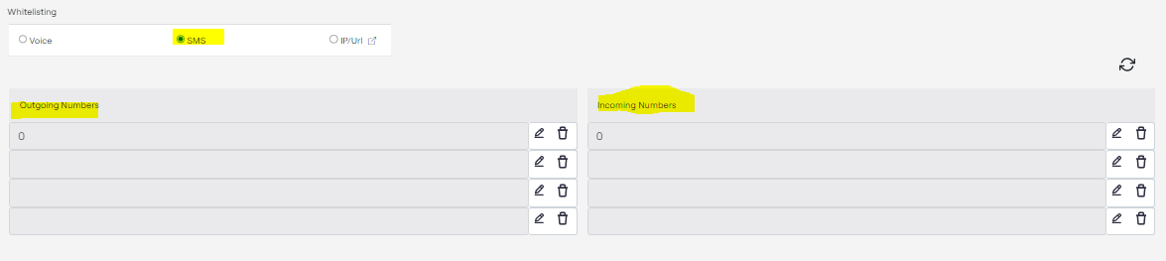
Whitelisting Pre-checks
Whitelisting for SMS services
Whitelisting for Voice services

Slide 18
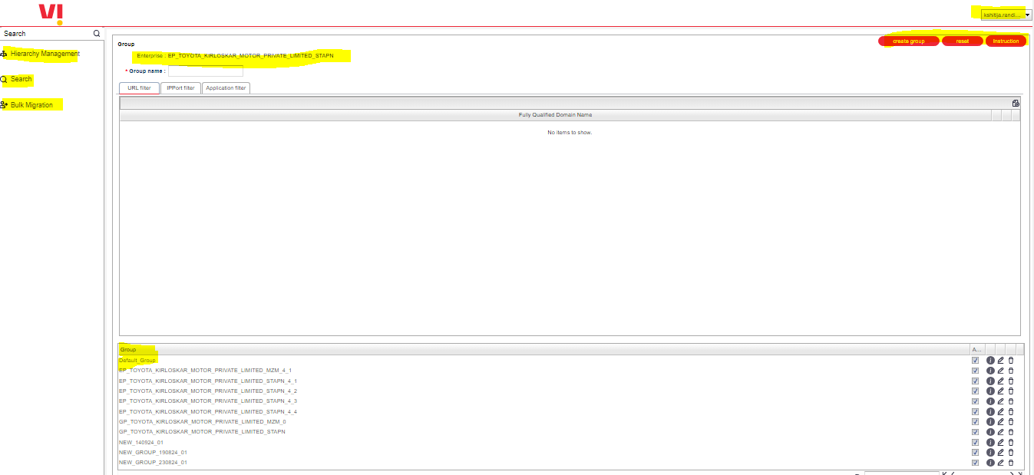
Whitelisting Pre-checks
Whitelisting for Data services on ISAFE portal

Slide 19
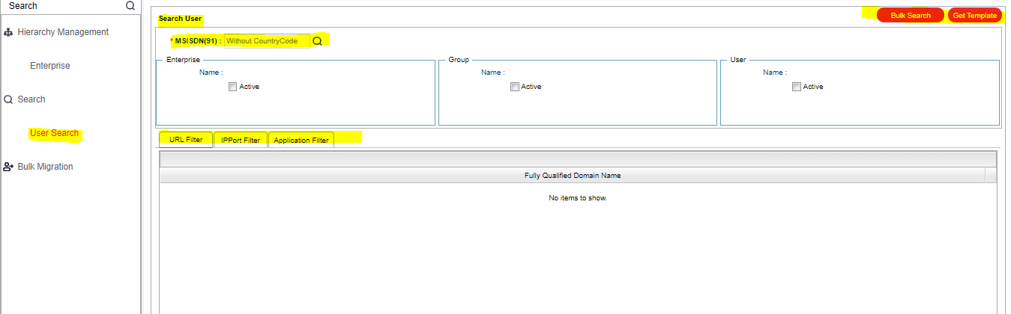
Whitelisting Pre-checks
In Search user you can check single numbers whitelisting

Slide 20
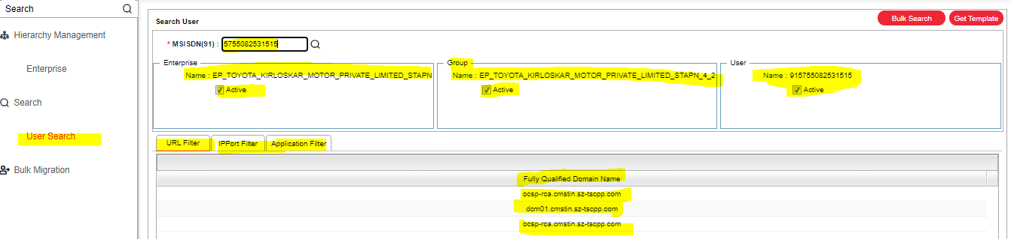
Whitelisting Pre-checks
For single number whitelisting will visible as below

Slide 21
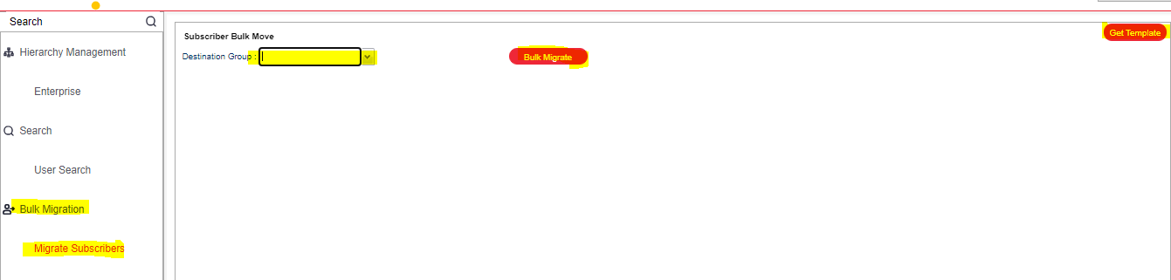
Whitelisting Pre-checks
For bulk search, you can use the Bulk Migrate option, but for whitelisting on bulk numbers you can update the file for the same

Slide 22
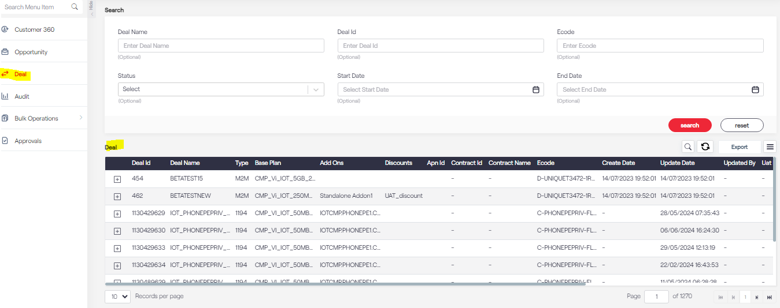
Whitelisting Pre-checks
In the Deal option, you will able to see the available deals for the particular customer which are activated at the backend

Slide 23
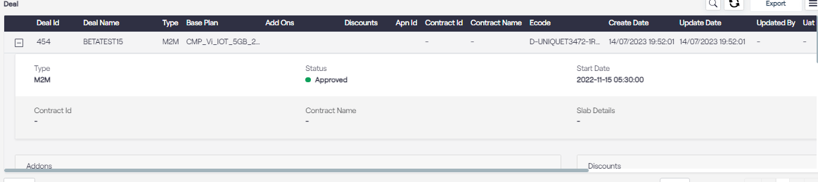
Deal Pre-checks

Slide 24
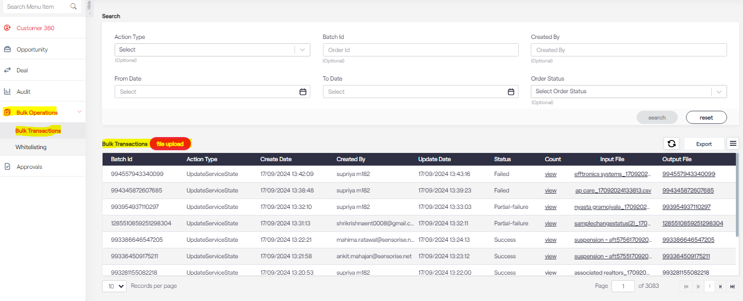
Bulk Operations

Slide 25
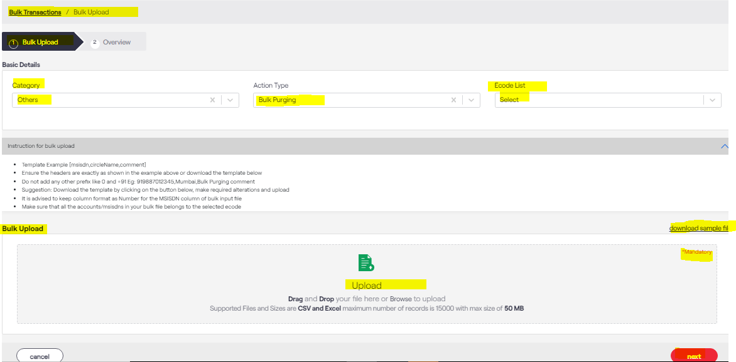
Bulk Operations
In Bulk Transaction, the customer can change the deal, change the status of the number, do the whitelisting for SMS and voice also can do the bulk purging

Slide 26
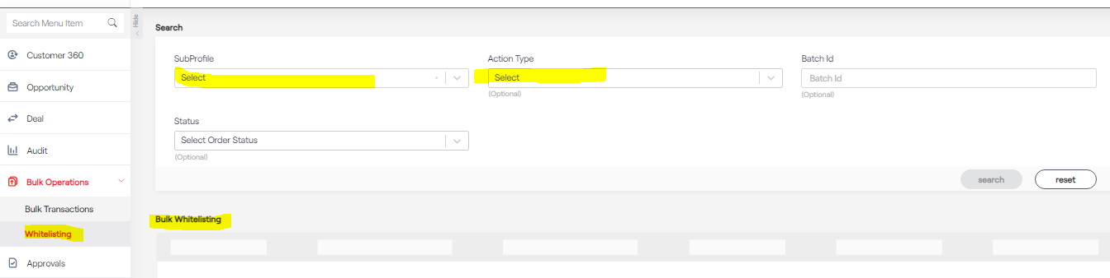
Whitelisting Operation
SMS and voice whitelisting can be done from Whitelisting option

Slide 27
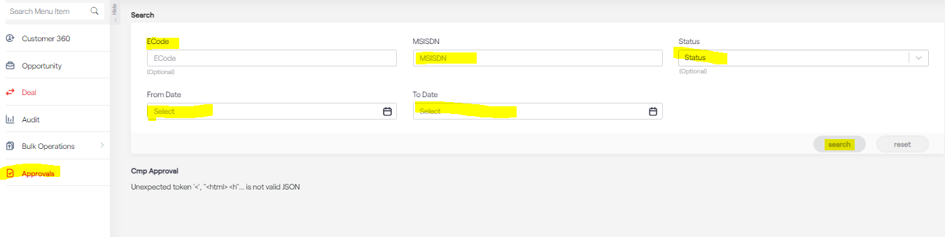
Approval Pre-checks
If the customer wants to suspend the number- those orders are pending in the approval option.

Slide 28
Thank You!

